Slide 1

Desing and Testing Problem 2 – Lesson 4 Repositories and Services
Ángel Delgado Luna

Slide 2
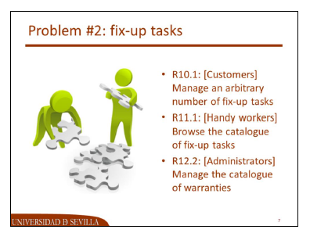
Index
Schema
UML Modeling
Requirement 10.1
Repository Implementation
Service Implementation
JUnit4 Test
Requirement 11.1
Repository Implementation
Service Implementation
JUnit4 Test
Requirement 12.2
Repository Implementation
Service Implementation
JUnit4 Test

Slide 3

Schema
FixUpTask
Service
Warranty
Service
Customer
Service
HandyWorker
Service
Administrator
Service
Customer
Repository
HandyWorker
Repository
Administrator
Repository
FixUpTask
Repository
Warranty
Repository

Slide 4
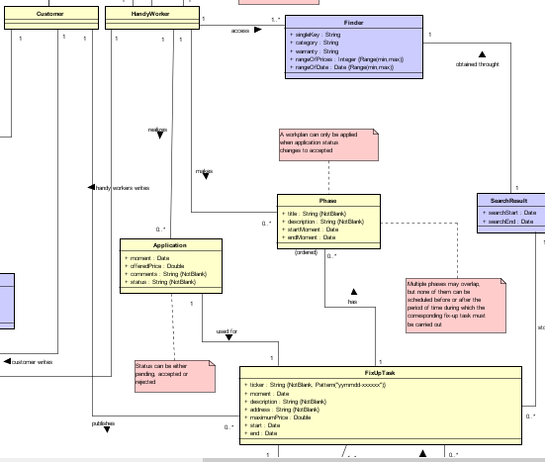
UML Modeling

Slide 5

Requirement 10.1 [Customers]
Manage an arbitrary number of fix-up tasks, which includes:
Listing (findAll())
Showing (findOne())
Creating (save(T e))
Updating (save(T e))
Deleting (delete (T e) or delete(id))

Slide 6
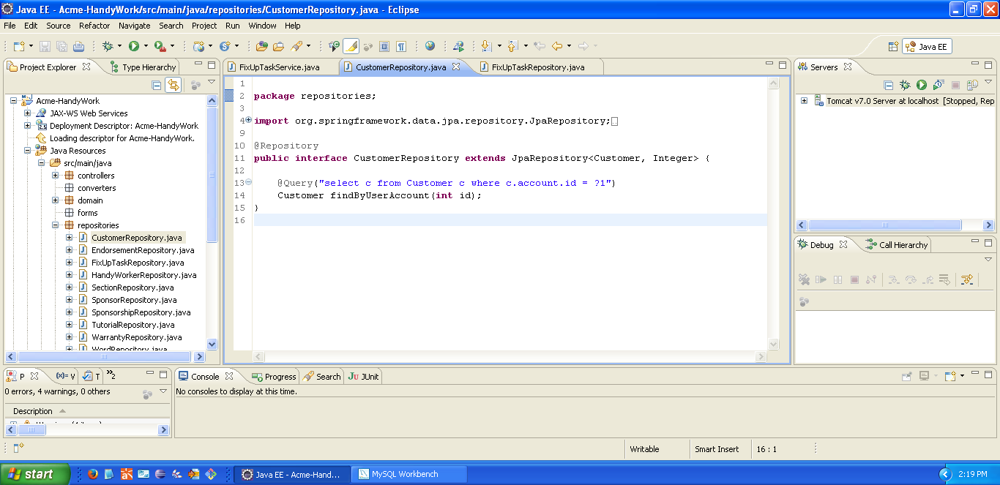
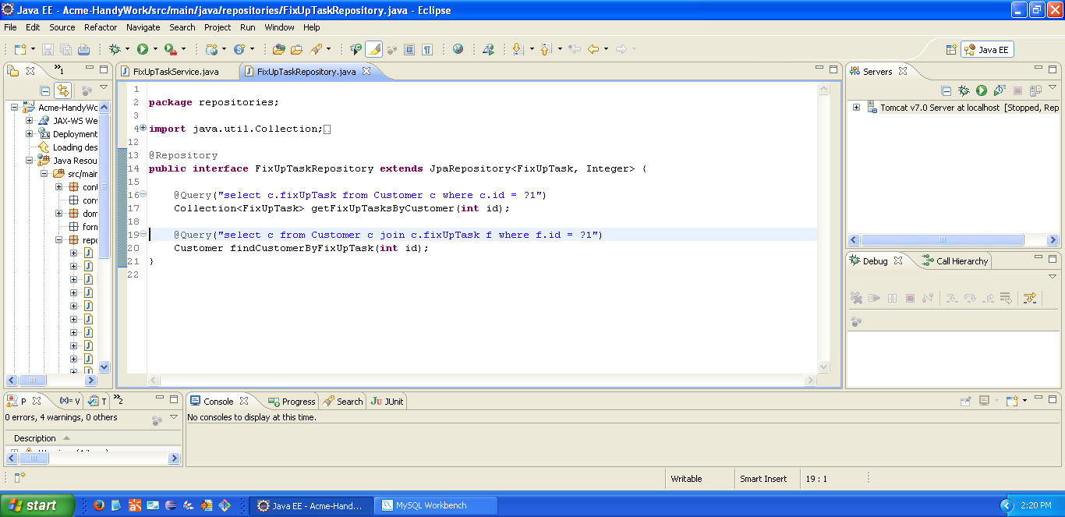
Repository Implementation
This query gets the customer who has made a certain FixUp

Slide 7

Requirement 11.1 [HandyWorkers]
Browse the catalogue of fix-up tasks and navigate to the profile of the corresponding customer, which includes his or her personal data plus his or her list of fix-up tasks.

Slide 8

Requirement 12.2 [Administrators]
Manage the catalogue of warranties, which includes:
Listing (findAll())
Showing (findOne())
Creating (save(T e))
Updating (save(T e))
Deleting (delete (T e) or delete(id))
A warranty can be updated or deleted as long as it is saved in draft mode. Once it’s saved in final mode, it cannot be edited or deleted. Only warranties that are saved in final mode can be referenced by fix-up tasks.

Slide 9
Repository Implementation
package repositories;
import org.springframework.data.jpa.repository.JpaRepository;
import org.springframework.stereotype.Repository;
import domain.Warranty;
@Repository
public interface WarrantyRepository extends JpaRepository<Warranty, Integer> {
}

Slide 10

Service Implementation
public Collection<Warranty> findAll() {
return this.repositoryWarranty.findAll();
}
public Warranty findOne(final int id) {
return this.repositoryWarranty.findOne(id);
}

Slide 11
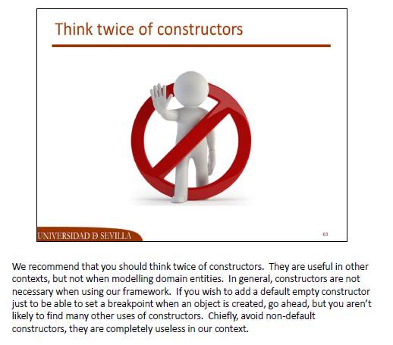

Service Implementation
public Warranty create() {
Warranty w;
w = new Warranty();
w.setTitle("");
w.setLaws("");
w.setTerms("");
w.setDraft(true);
return w;
}
public Warranty addWarranty(final Warranty w) {
Assert.notNull(w);
return this.repositoryWarranty.save(w);
}

Slide 12


Service Implementation
public Warranty updateWarranty(final int id, final Warranty newer) {
Warranty w;
w = this.findOne(id);
if (w.isDraft()) {
w.setTitle(newer.getTitle());
w.setTerms(newer.getTerms());
w.setLaws(newer.getLaws());
}
return this.repositoryWarranty.save(w);
}
public void deleteWarranty(final int id) {
Warranty w;
w = this.findOne(id);
if (w.isDraft())
this.repositoryWarranty.delete(w);
else
throw new IllegalAccessError();
}

Slide 13
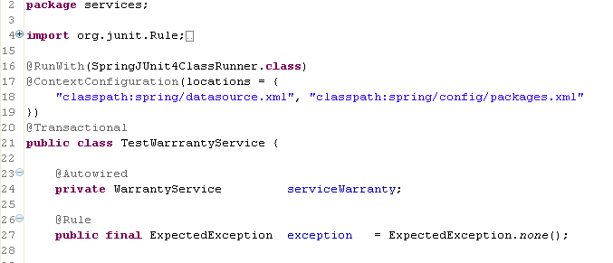

JUnit4 Test

Slide 14
JUnit4 Test
Test Case | Code
Listing warranties | @Test public void testGetAll() { Assert.isTrue(this.serviceWarranty.findAll().size() >= 0); }
Showing a warranty | @Test public void testGetById() { Assert.notNull(this.serviceWarranty.findOne(1128)); }
Creating a warranty | @Test public void testCreate() { Warranty w, saved; Collection<Warranty> warranties; w = this.serviceWarranty.create(); w.setTitle("Ley 1933/2018"); w.setLaws("Real decreto ley 1998/2001"); w.setDraftMode(true); w.setTerms("Terminos de la garantia que aplicar"); saved = this.serviceWarranty.addWarranty(w); warranties = this.serviceWarranty.findAll(); Assert.isTrue(warranties.contains(saved)); }

Slide 15
JUnit4 Test
Test Case | Code
Updating a warranty in draft mode | @Test public void testUpdate1() { Warranty w; w = this.serviceWarranty.findOne(1129); w.setTitle("Testeando garantia"); Assert.notNull(this.serviceWarranty.updateWarranty(1129, w)); }
Deleting a warranty in draft mode | @Test public void testDelete1() { Assert.notNull(this.serviceWarranty.findOne(1129)); this.serviceWarranty.deleteWarranty(1129); Assert.isNull(this.serviceWarranty.findOne(1129)); }
Updating a warranty in non draft mode | The same as before, but using 1129 warranty id.
Deleting a warranty in non draft mode

